Slide 1
objective: TO TRACK UPDATE OF C COVID 19 COVID 19
Covid tracker
USERS OF THE SYSTEM:
- ADMIN
-CUSTOMERS Functional Requirements:
1.Additional information of Covid 19 are given in Read More.
2.Each Side navigation icons has its own specific contents.
3.Vaccinated and Non-Vaccinated are also mentioned with the percentage

Slide 2
4.Vaccine 1st and 2nd doses are vaccinated by 54.9% of the people in India currently.
5.Affected people of covid 19 are differentiated by Confirmed, Active, Deceased, Recovered.
6.Total number of people vaccinated doses are also administrated. 7.The tabular column referred here is mentioned the number of people affected by Covid 19 are differentiated by State wise and differentiated by Confirmed, Active, Deceased, Recovered.
8.India map mentioned here indicates the states with coloured effects mentions the covid affected and delivers contents of states.
9.Rate of unemployment because of covid 19
10.Death rate according to age group

Slide 3

11.demands of mask and other medical facilities
12.percentage of the student dropped in education
13. percentage of the people immigrated to the hometown\cities\countries.
14.Rate of mental health of the people
15.Demand and scarcity of food (pie chart)
Technology Stack FRONT END: HTML, CSS, JAVASCRIPT
VALIDATION: 1. basic email validation should be performed

Slide 4
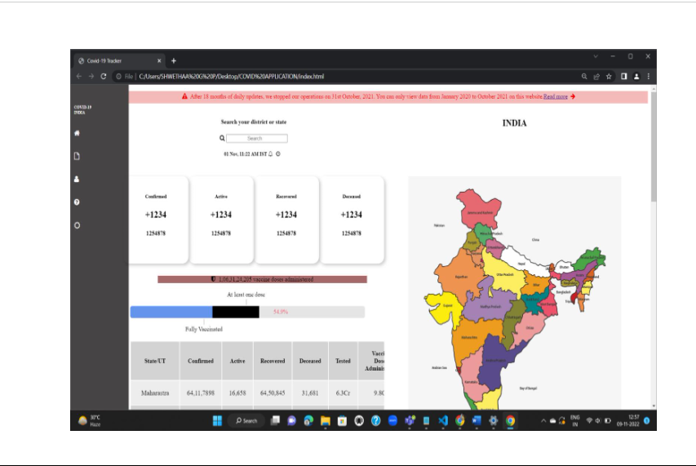

Slide 5
Non-Functional Requirements: Security ● WEBSITE PLATFORM –User Name/Password-Based Credentials ● Sensitive data has to be categorized and stored in a secure manner ● Secure connection for transmission of any data

Slide 6
Performance:
ACTIVE CASES <5 SEC
CONFORMED CASES < 5 SEC
DEATH CASES <5 SEC
RECOVERED CASES <5 SEC

Slide 7
OUTPUT/POST CONDITION: 1. WE WILL GET THE PERCENCTAGE OF PEOPLE AFFECTED BY COVID 2.TRACK THE AREA MOSTLY AFFECTED BY COVID 19 3.OXYGEN CYLINDER, MEDICAL FACILITIES,FOOD SERVICES DATA AVAILABILITY

Slide 8



Presentation by: LEADING TRACKER Team leader: SANDHYA K
Members: Reshma P
Nisha R.R Santhiya. M Yuvasri B Manvi pareek

Slide 9

THANK YOU
For the given opportunity

